Slide 1
FUNNEL-TRANSFORMER: Filtering out Sequential Redundancy for Efficient Language Processing
By Sumit Dutt Mishra

Slide 2
Funnel Transformer
Funnel-Transformer which gradually compresses the sequence of hidden states to a shorter one and hence reduces the computation cost.
Funnel-Transformer can recover a deep representation for each token from the reduced hidden sequence via a decoder.

Slide 3
Transformer Architecture
Transformer layer consists of two sub-modules
Multi-head self-attention(S-Attn)
Position-Wise feed-forward network(P-Attn)

Slide 4
Pretraining Objectives:
The most used pretraining model is masked language modeling(MLM) used by BERT.

Slide 5
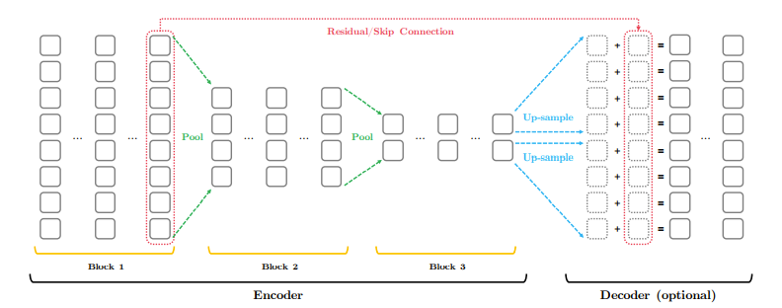
Proposed Architecture

Slide 6
Capacity Analysis
We can now analyze how to compress the sequence which affects the complexity and capacity of proposed model, when compared to standard Transformer.
the complexity of processing a length-T sequence O(T 2D + T D2 ), where D is hidden size
The capacity of a compressed-length layer is clearly upper-bounded by that of a normal full-length layer.

Slide 7
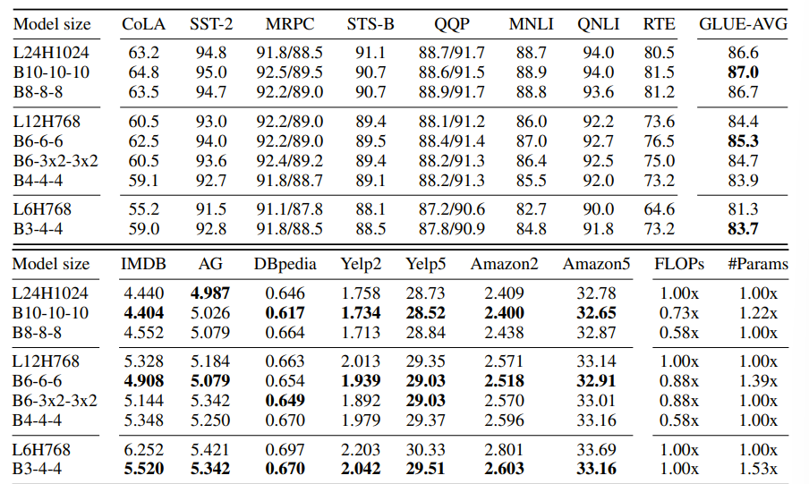
Results

Slide 8
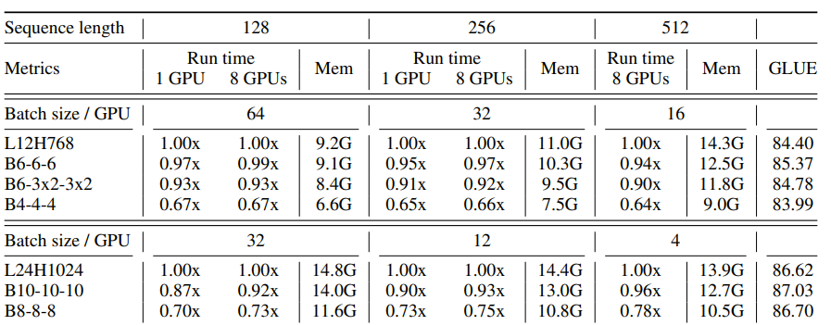
Results:
Running time and memory consumption comparison between F-TFMs and the standard transformer on the GPU.

Slide 9
Conclusion:
we explained how sequential resolution can be compressed in a simple form to save computation and how the saved FLOPs can be re-invested in improving the model capacity and hence the performance.
Trying to improve the compression scheme, to optimize the block layout design and to re-invest the saved FLOPs.

Slide 10


